Slide 1
Workshop: Go for entrepreneurship instead of employment
Oslo,
25 Nov. 2021

Slide 2
Introduction to CPN & the project
Dr. Xiuhua Zhang
Oslo, 3rd November

Slide 3
Project: Go for a job or en entrepreneur?
Funded by Oslo Kommunen Bydel for 2022
Background
Different choices/opportunities for immigrants/working labors to work with their carriers
Post Covid-19 pandemic and war
How to make the right carrier options when you have a business idea, but still working in a company?
Aim
Learn the knowledge about the job and entrepreneurship
Make an analysis of thoughts behind the carrier options
Two groups: job seekers and entrepreneurs
Share experiences with others

Slide 4
Employees
Notes:
Employment is when you work for another company, have an employment contract, fixed working hours, and a regular monthly salary. As an employee, you will have bosses, so there is no flexibility in the decision-making process. Also, you will work according to procedures created by other people.

Slide 5
Self-Employees
Notes:
Self-employment is a business that provides a job for you as a business owner. You are working for yourself without defined working hours. The only boss, in that case, will be your customers, but you will have flexibility in the decision-making process. The focus is on your technical skills.

Slide 6
Entrepreneurship
Notes:
Entrepreneurs create a business that requires a team of people and more resources that the entrepreneur will adequately manage. You will manage and work for your own company without defined working hours as an entrepreneur. You will be in the top management with the highest possible flexibility in the decision-making process. As an entrepreneur, you will need technical, entrepreneurial, and managerial skills.

Slide 7
Characters of entrepreneurship
1. You are your boss when you are an entrepreneur instead of an employee
2. You own your time and make your own decisions for your business
3. Unlimited opportunity for income, if you are success
4. Entrepreneurs are happier and healthier than employed people
5. Building a business is more satisfying
6. You feel more motivated as an entrepreneur instead of being employed
7. As an entrepreneur, you can live the lifestyle you like
8. You Can Work From Anywhere
9. If You are an Entrepreneur, There is No Dress Code like When You Are Employed
10. Flexibility and Independence

Slide 8
Project activities
Workshop 1: Go for entrepreneurship instead of employment, 3rd November
One-to-One supervising on CV and job application by request: Please register you by ticking your name at list
Gathering 1: 13 Nov. Sunday, In cooperation with Student association, UiO
Workshop 2: About job seeking, 3rd December?
Gathering 2: Visit NIO Oslo, Date to be decided soon.
Questionaries, Analysis and report
More information via mail and website
Register you at workinginnorway.no

Slide 9
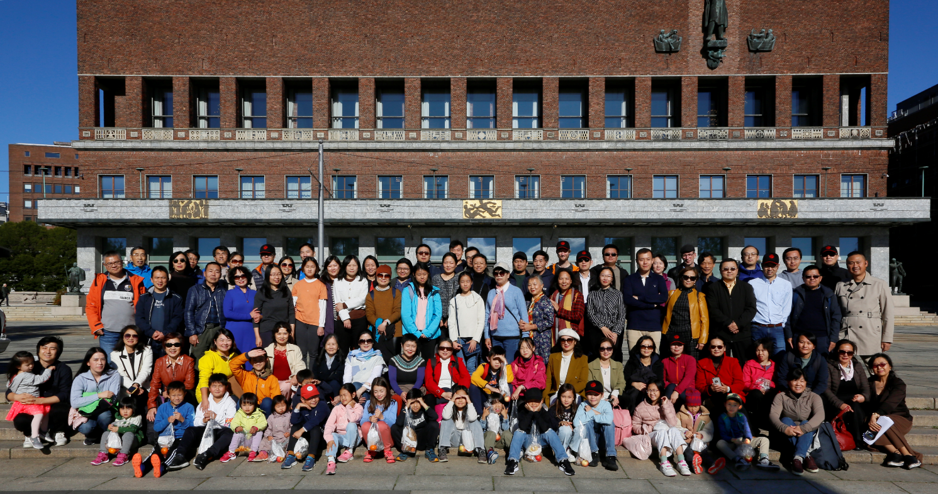
Introduction to CPN & the project
Dr. Xiuhua Zhang
Oslo, 3/11 2022

Slide 10
CPN- Gather professionals and talents together & develop multiple exchange and collaboration
To provide a professional platform and enhance communication among Chinese living in Norway and facilitate fellow members’ career advancement and academic achievement
To promote mutual understanding and friendship between people of Norway and.
To enhance communications and cooperation between Norway and China in areas such as: culture and education, business and economy, science and technology, social development, etc.
To provide consulting services for relevant organizations and enterprises in China and Norway.
To promote cultural diversity and encourage active integration of the immigrants into the Norwegian society based on the abiding Norwegian laws and regulations.

Slide 11
What we do?
1
Developing social/professional network
2
Sharing information/knowledge
3
Innovation and Entrepreneurship
4
Promoting and connecting collaboration between China and Norway

Slide 12
Profile of CPN
A Professional Association established in Oct. 2003 (CPN for short, cpn2003.no)
CPN membership requires degrees of higher education and Chinese roots
Over 1500 registered members: One academician, 4 professors, 1/4 PhD/Dr.degree，1/2 master degree and rest bachelor; including student membership
Major and scientific background: all subjects, i.e., nature science, medicine, engineering, art design, social science etc. IT and economy/finance dominated
Working in all kinds of organizations: public and private sectors; universities/colleges, research institutions, and companies, self-employees etc.
CPN Junior Club
Running Competence Center for Immigrants since 2013 supported by IMDI and Oslo Kommunen
‘Top 10 Immigrants 'award: Five CPN’s members awarded in 2005，2008，2009, 2011 and 2012

Slide 13
Give us your reason for being an entrepreneur , your feedback is important!
CPN website
QR code
cpn2003.no &
workinginnorway.no

